Slide 1
《英语国家社会与文化入门》(下册）
The Society and Culture
of Major English-Speaking Countries
An Introduction
(Book Two)

Slide 2
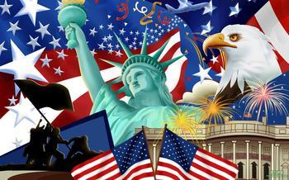
The United States of America
Unit 6 Religion in the United States

Slide 3
Quiz
Give the English and a brief explanation for the following:
1 清教徒
2 美国宪法第一修正案
3 贵格派教徒
4 罗马天主教徒
5 反犹主义

Slide 4
Focal Points
American history and religious liberty
the U.S. Constitution and religion
Protestants and different Protestant groups in the U.S.
Catholics in the U.S.
Jews and their religious faith
religious diversity in the U.S.
characteristics of American religious beliefs

Slide 5
This Unit Is Divided into Six Sections
Religious Liberty
Protestants in the United States
Catholics
Three Faiths
Religious Diversity
American Character of Religion

Slide 6
I. Religious Liberty
By the middle of the 18th century, many different kinds of Protestants—Lutherans, the Dutch Reformed Church, Presbyterians, Huguenots and Puritans--lived in harmony in America.
The Declaration of Independence states, “all men are created equal, that they are endowed by their creator with certain unalienable rights.” Among the rights, as a political necessity in a religiously diverse society, was freedom of religion.
The First Amendment to the Constitution of the United States forbade the new federal government to give special favors to any religion or to hinder the free practice, or exercise, of religion.
Various religious faiths have flourished, as well as perished, in the United States.

Slide 7
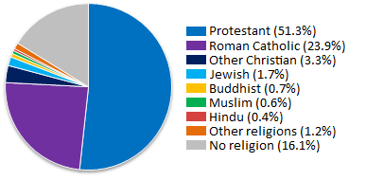
II. Protestants in the United States
Protestants are the largest religious group in the US, with half of the population identifying themselves as Protestants.
Figure in 2009

Slide 8
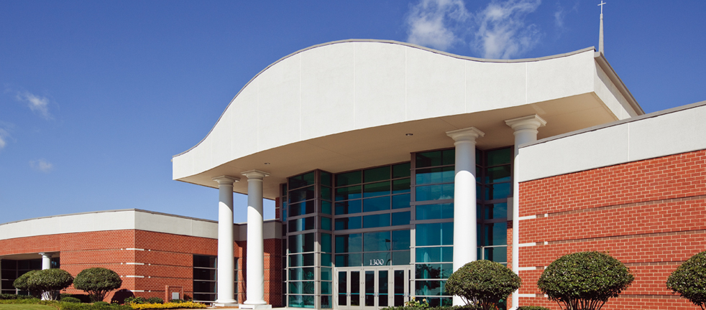
II. Protestants in the United States
The Baptists are the largest Protestant group. They believe in adult baptism by immersion, symbolizing a mature and responsible conversion experience. In 2009, the denomination had 1.3 million members in over 5000 churches in the US. (Below is the newly built Fairview Baptist Church in South Carolina)

Slide 9
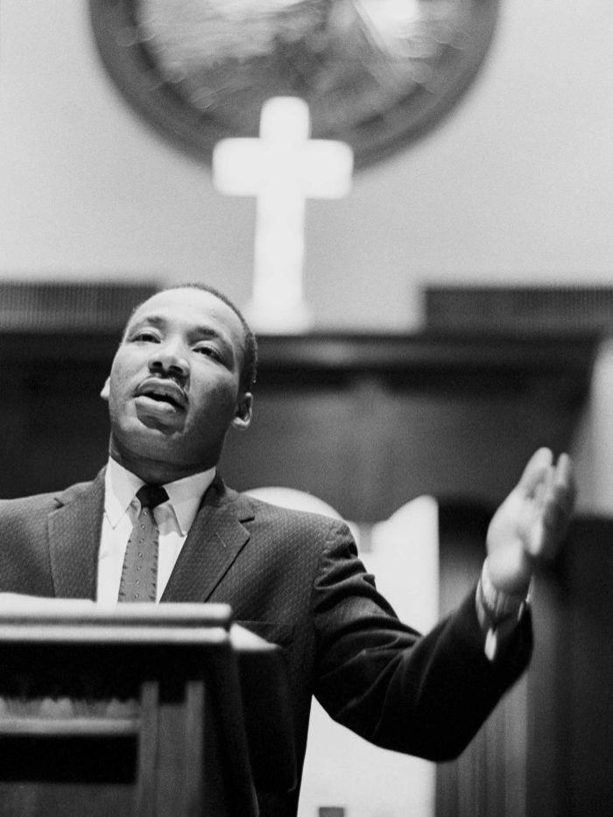
II. Protestants in the United States
Most of the African-Americans are Baptists, but they go to different churches from the white. In southern communities the African-Americans find their main social center in their Baptist churches and sometimes a base from which to organize group action. Martin Luther King, Jr, a Baptist minister and social activist, led the civil rights movement in the US from the mid-1950s until his death by assassination in 1968.

Slide 10
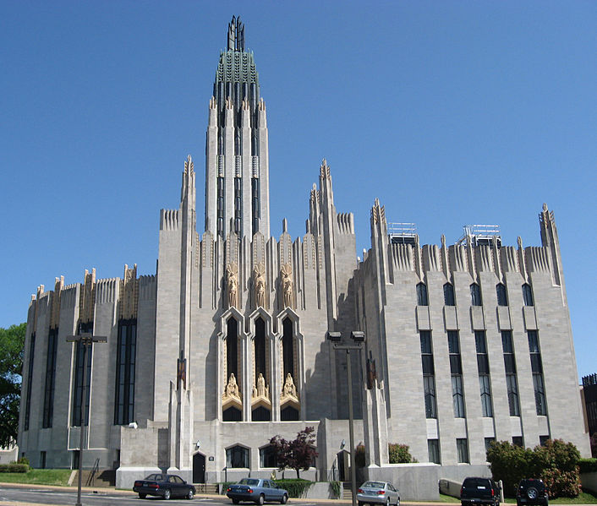
II. Protestants in the United States
The Methodists are next to the Baptists, the most numerous Protestants. The Methodists are adherents of the group which grew up in 18th century England. Most Methodists are united in the Methodist Church, which has a form of service based on that of the Church of England. (Right: Boston Avenue Methodidst Church)

Slide 11
II. Protestants in the United States
Presbyterians and Episcopalians are the other two large Protestant groups.
There are more than 100 other Protestant sects, many of them hardly known to anyone except their own members, but with a combined membership of more than 20 million.
They express variety, rather than doctrinal schism. Some of them are of recent foundation, and the dominant trend is fundamentalist. Four of the smaller sects are really quite large, with 2 million or more members.

Slide 12
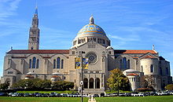
III. Catholics
The largest single religious group is that of Roman Catholics.
78.2 million people in the US are self-identified Catholics, about one quarter of the country’s population.
The majority of the Catholics are descendants of immigrants from Ireland, Italy and Poland. Most of the early Catholics stayed near the East Coast. They were concentrated especially in New York and Massachusetts, and are still a very important element of the population in those two states.
The Basilica of the National Shrine of the Immaculate Conception in Washington, D. C. the largest Catholic church in the US

Slide 13
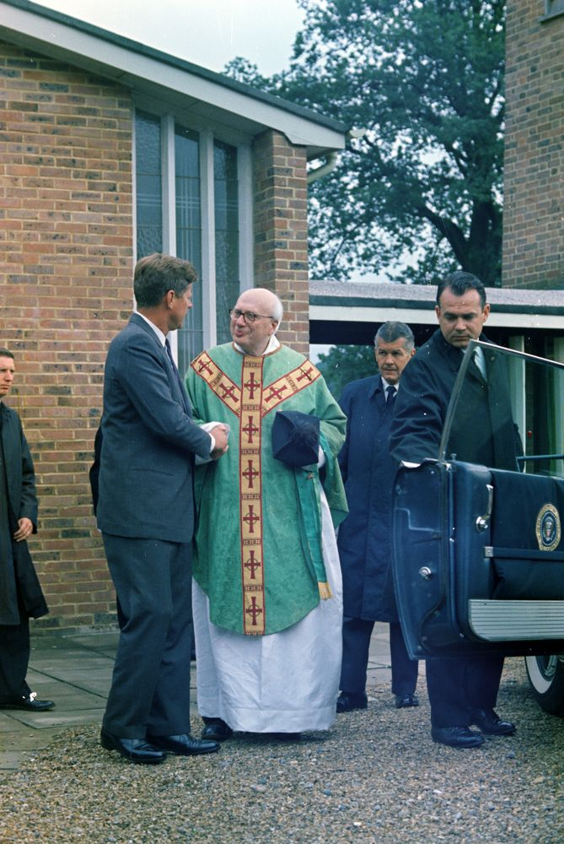
III. Catholics
Anti-Catholicism
Hostility to Catholics and their Church was prominent among Protestants in Britain and Germany from the Protestant Reformation onwards. Immigrants brought that hostility with them to the American colonies. By 1960, however, John F. Kennedy’s presidential election victory put to rest the Catholic religion as an issue in national politics. Kennedy was a Roman Catholic.
President John F. Kennedy Departs Church in England

Slide 14
III. Catholics
By the 1950s, many Catholics had risen to positions of leadership, not only in labor unions, but also in business and politics as well. As Catholics grew more confident about their place in American life.
Catholics were not shut out of public schools and hospitals but they wanted their own schools, colleges and hospitals. Catholics believed that these institutions were needed to preserve their faith. Many Catholics now attend public schools and secular colleges. But Catholic institutions, especially in large cities, still serve large numbers of Catholics and a growing number of non-Catholics, who are attracted by the discipline and education offered in these schools.

Slide 15
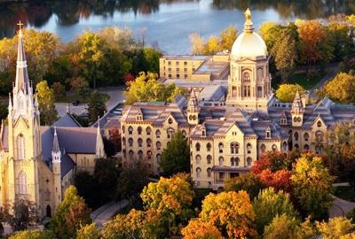
III. Catholics
The University of Notre Dame is a Catholic research university located in Indiana, in the United Stated. The school was founded by Father Edward Sorin, who was also its first president. Today, many Holy Cross priests continue to work for the university, including as its president.

Slide 16
IV. Three Faiths
After Christianity, Judaism is the next largest religious affiliation in the US, though this identification is not necessarily indicative of religious beliefs or practices. There are between 5.3 and 6.6 million Jews. A significant number of people identify themselves as American Jews on ethnic and cultural grounds, rather than religious ones.
When Jews began coming to America in great numbers in the 19th century, anti-Semitism appeared.
By the 1950s, a kind of "three faiths" model of the United States had developed. Americans were considered to come in three basic varieties: Protestant, Catholic and Jewish, the order reflecting the strength in numbers of each group.

Slide 17
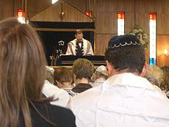
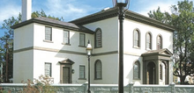
Judaism
A synagogue is a Hewish house of prayer. The Touro Synagogue is a 1763 synagogue in Newport, Rhode Island, that is the oldest synagogue building still standing in the United States.
Reform Jewish service

Slide 18
IV. Religious Diversity
The United States has always been a fertile ground for the growth of new religious movements. Frontier America provided plenty of room to set up a new church or found a new community.
Many religious communities and secular utopias, or experiments in new forms of social living, were founded in 18th and 19th century America.
Small sects and “cults” do have certain tendencies in common. Often they regard the larger society as hopelessly corrupt. Some groups, like the Amish of Pennsylvania, simply want to be left alone in their rural communities. They wish to keep their children out of high school so they will not be affected by modern society.
A few prefer faith healing to modern medicine or object to certain medical practices.

Slide 19
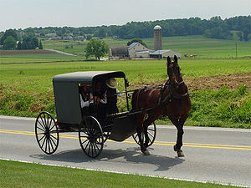
IV. Religious Diversity
The Amish are a group of traditionalist Christian church fellowships, with Swiss origins. The Amish are known for simple living, plain dress, and reluctance to adopt many conveniences of modern technology. It is common to find an Amish family still riding in a traditional buggy.

Slide 20
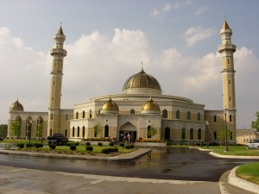
IV. Religious Diversity
Other world religions are increasing their numbers and influence in America such as Islam. The exact size of the Muslim population in the United States is very difficult to determine. There are different estimates, and the most accepted estimate is that around 5 million members of the Islamic religion live in America today. Some are immigrants or the children of immigrants; others are Americans, including African Americans who have converted to Islam.
Islamic Center of America

Slide 21
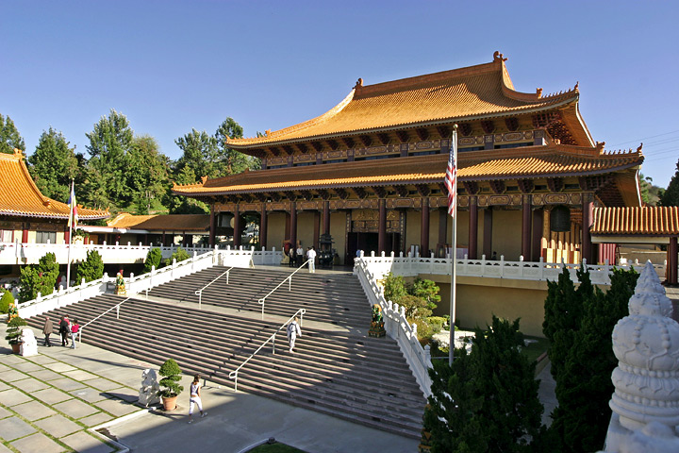
IV. Religious Diversity
Buddhism is a also growing faith in America. Recent immigration from Asia has raised the number of Buddhists in America considerably over the past decades, but again it is not easy to make the exact figure since many of those who claim to be Buddhists do not go to a Buddhist temple for regular religious service, but instead worship at home.
Hsi Lai Temple in California, one of the largest of its kind in North America

Slide 22
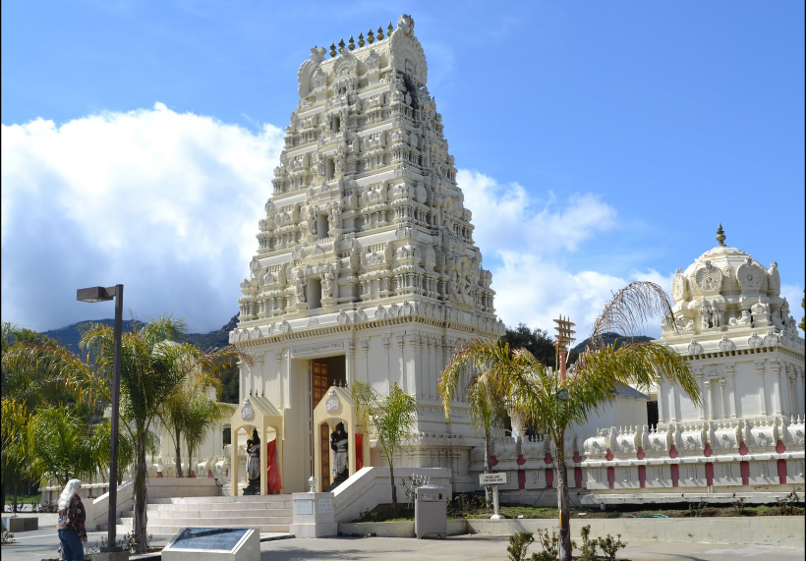
IV. Religious Diversity
Around 1.1 million Hindus live in America. In recent years, young native-born Americans have shown great interest in these and other eastern religions and philosophies.
Malabu Hindu Temple in California

Slide 23
V. American Character of Religion
First, Americans with different religions live together under the same law. The Bill of Rights in the U.S. Constitution insists that there should be no state religion. That means that the government has no right to interfere in people’s religious affairs. The freedom of religion and the separation of state and church guaranteed in the Constitution are believed to be the basic principles against religious persecution. Due to this tradition and the basic law about religion, various religious groups in America have coexisted more harmoniously than the Old World.

Slide 24
V. American Character of Religion
Secondly, the religious beliefs of Americans continue to be strong with social progress. Half of American Protestants are active church members, and there are few who habitually stay away. Not only the Catholic churches, but the Protestant ones too, are flourishing, and new church buildings, some with interesting architecture, keep pace with the ever-growing suburbs. In America, through all the social and economic changes religion has remained a constant factor.

Slide 25
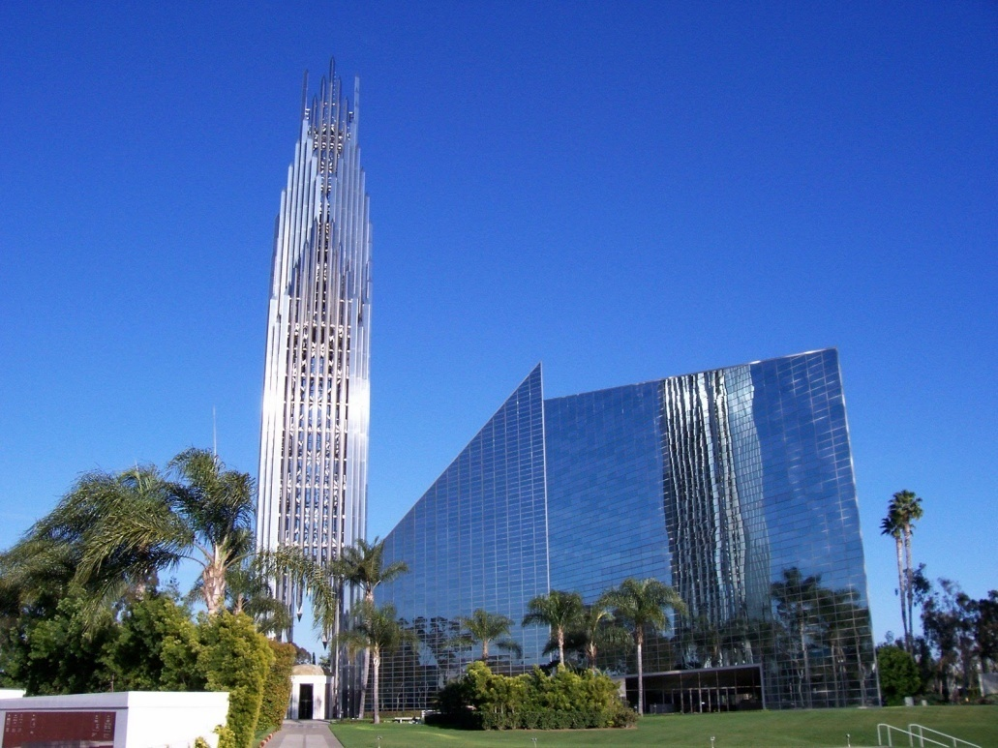
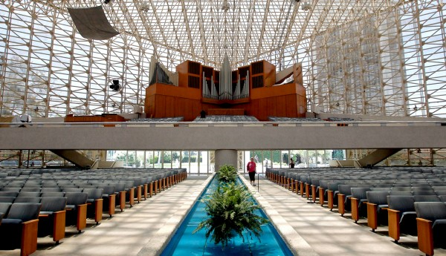
V. American Character of Religion
Crystal Cathedral in California has become a major tourist attraction.
Crystal Cathedral in California (inside)

Slide 26
V. American Character of Religion
Thirdly, in the United States every church is an independent organization, and concerned with its own finance and its own building. There has been little concentration on doctrine or religious argument such as in European history. Churches and religious sects are expressions of group solidarity rather than of rigid adherence to doctrine. Baptist ministers are invited to preach in Methodist churches. Exchange of pulpits has been common for many years. People go to church, and it helps them feel that they have a place in a community.

Slide 27
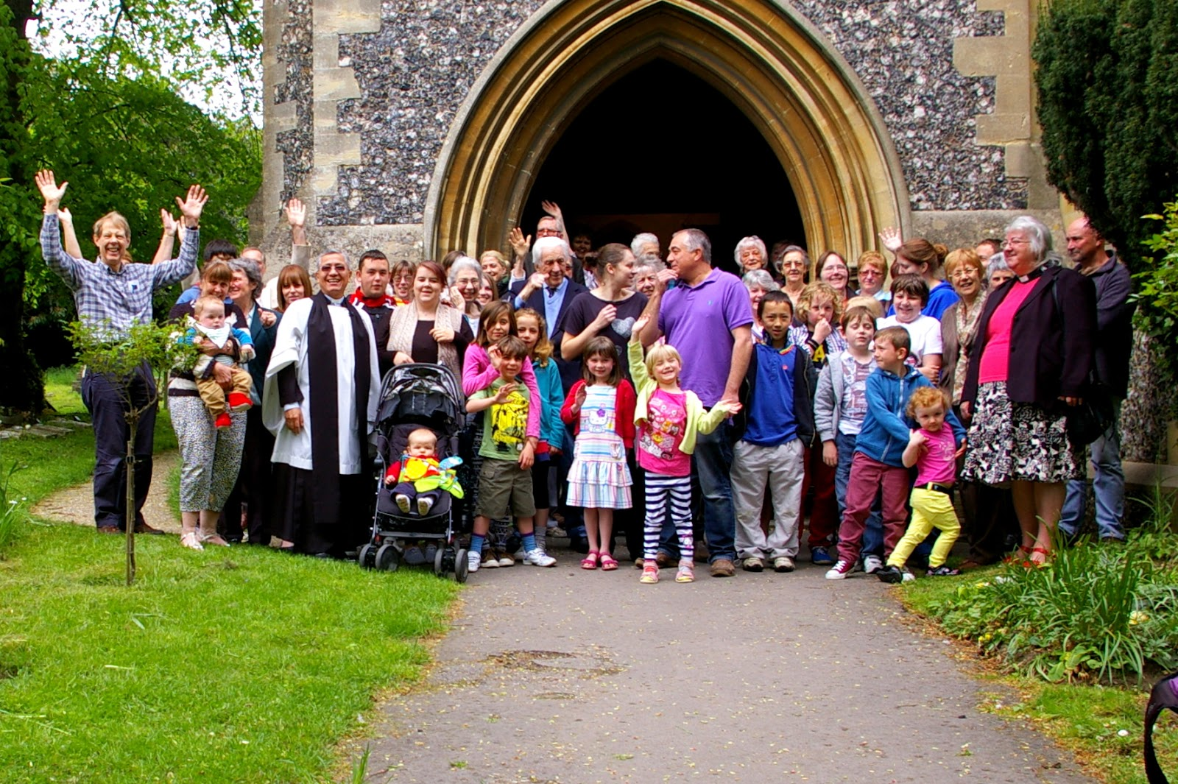
V. American Character of Religion
The Church as a community

Slide 28
Questions for Discussion
A. In what way do you think that religious freedom was a historical necessity in the United States?
B. What is the relationship between government and religion in America?
C. What promotes the diversity in American religion?
D. What are some of the features in religion that are particularly American? What are some of the major differences between American religion and religion in Europe?

Slide 29
The End
高等教育出版社
2015

